Slide 1
Introduction to Data Structures & Algorithms
Unit I

Slide 2
What is Data Structure?
The data structure name indicates itself that organizing the data in memory.
There are many ways of organizing the data in the memory as we have already seen one of the data structures,
i.e., array in C language.
Array is a collection of memory elements in which data is stored sequentially, i.e., one after another.
In other words, we can say that array stores the elements in a continuous manner.
This organization of data is done with the help of an array of data structures.

Slide 3
Cont…
There are also other ways to organize the data in memory. Let's see the different types of data structures.
The data structure is not any programming language like C, C++, java, etc. It is a set of algorithms that we can use in any programming language to structure the data in the memory.
To structure the data in memory, 'n' number of algorithms were proposed, and all these algorithms are known as Abstract data types.

Slide 4
Data Structure
introduction
Data Structure can be defined as the group of data elements which provides an efficient way of storing and organising data in the computer so that it can be used efficiently.
Some examples of Data Structures are arrays, Linked List, Stack, Queue, etc. Data Structures are widely used in almost every aspect of Computer Science
i.e. Operating System, Compiler Design, Artificial intelligence, Graphics and many more.
Data Structures are the main part of many computer science algorithms as they enable the programmers to handle the data in an efficient way.
It plays a vital role in enhancing the performance of a software or a program as the main function of the software is to store and retrieve the user's data as fast as possible

Slide 5
Basic Terminology
Data structures are the building blocks of any program or the software. Choosing the appropriate data structure for a program is the most difficult task for a programmer. Following terminology is used as far as data structures are concerned
Data: Data can be defined as an elementary value or the collection of values, for example, student's name and its id are the data about the student.
Group Items: Data items which have subordinate data items are called Group item, for example, name of a student can have first name and the last name.
Record: Record can be defined as the collection of various data items, for example, if we talk about the student entity, then its name, address, course and marks can be grouped together to form the record for the student.

Slide 6
File: A File is a collection of various records of one type of entity,
for example, if there are 60 employees in the class, then there will be 20 records in the related file where each record contains the data about each employee.
Attribute and Entity: An entity represents the class of certain objects. it contains various attributes. Each attribute represents the particular property of that entity.
Field: Field is a single elementary unit of information representing the attribute of an entity.

Slide 7
Entity :Student
Attributes:
name, roll, address, phone_no : attributes
Entity
car
Attributes:
Color
Size
weight

Slide 8
Operations on data structure
1. Traversing: Every data structure contains the set of data elements. Traversing the data structure means visiting each element of the data structure in order to perform some specific operation like searching or sorting.
Example: If we need to calculate the average of the marks obtained by a student in 6 different subject, we need to traverse the complete array of marks and calculate the total sum, then we will divide that sum by the number of subjects i.e. 6, in order to find the average.
2. Insertion: Insertion can be defined as the process of adding the elements to the data structure at any location.
If the size of data structure is n then we can only insert n-1 data elements into it.
3. Deletion: The process of removing an element from the data structure is called Deletion. We can delete an element from the data structure at any random location.

Slide 9
Cont…
4. Searching: The process of finding the location of an element within the data structure is called Searching.
There are two algorithms to perform searching, Linear Search and Binary Search.
5. Sorting: The process of arranging the data structure in a specific order is known as Sorting.
There are many algorithms that can be used to perform sorting, for example, insertion sort, selection sort, bubble sort, etc.
5. Merging: When two lists List A and List B of size M and N respectively, of similar type of elements, clubbed or joined to produce the third list, List C of size (M+N), then this process is called merging
6. updating:

Slide 10
Need of Data Structures
As applications are getting complex and amount of data is increasing day by day, there may arise the following problems:
Processor speed: To handle very large amount of data, high speed processing is required, but as the data is growing day by day to the billions of files per entity, processor may fail to deal with that much amount of data.
Data Search: Consider an inventory size of 106 items in a store, If our application needs to search for a particular item, it needs to traverse 106 items every time, results in slowing down the search process.
Multiple requests: If thousands of users are searching the data simultaneously on a web server, then there are the chances that a very large server can be failed during that process
in order to solve the above problems, data structures are used. Data is organized to form a data structure in such a way that all items are not required to be searched and required data can be searched instantly.

Slide 11
Types of Data Structures
There are two types of data structures:
Primitive data structure /primitive data type
Non-primitive data structure / non-primitive data type

Slide 12
Primitive Data structure
The primitive data structures are primitive data types.
int, char, float, double, and pointer are the primitive data structures that can hold a single value.
Non-Primitive Data structure
The non-primitive data structure is divided into two types:
  Linear data structure
  Non-linear data structure

Slide 13
Linear Data Structure
The arrangement of data in a sequential manner is known as a linear data structure.
The data structures used for this purpose are Arrays, Linked list, Stacks, and Queues.
In these data structures, one element is connected to only one another element in a linear form.

Slide 14
Non-linear data structure
When one element is connected to the 'n' number of elements known as a non-linear data structure.
The best example is trees and graphs. In this case, the elements are arranged in a random manner.

Slide 15
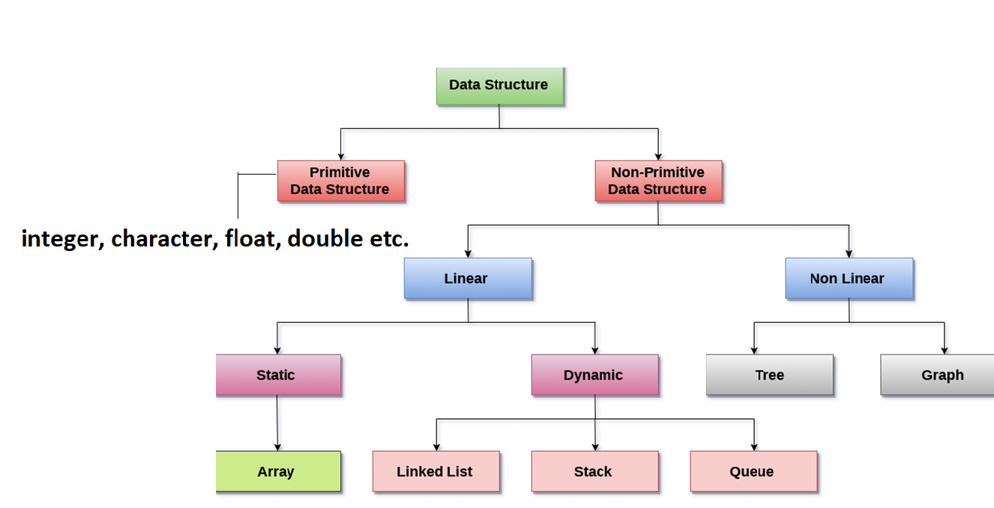

Slide 16
Data structures can also be classified as:
Static data structure: It is a type of data structure where the size is allocated at the compile time. Therefore, the maximum size is fixed.
Dynamic data structure: It is a type of data structure where the size is allocated at the run time. Therefore, the maximum size is flexible.

Slide 17
Major Operations
The major or the common operations that can be performed on the data structures are:
Searching: We can search for any element in a data structure.
Sorting: We can sort the elements of a data structure either in an ascending or descending order.
Insertion: We can also insert the new element in a data structure.
Updating: We can also update the element, i.e., we can replace the element with another element.
Deletion: We can also perform the delete operation to remove the element from the data structure.

Slide 18
Abstract Data Type in Data Structures
The Data Type is basically a type of data that can be used in different computer program. It signifies the type like integer, float etc, the space like integer will take 4-bytes, character will take 1-byte of space etc.
The abstract datatype is special kind of datatype, whose behavior is defined by a set of values and set of operations.
The keyword “Abstract” is used as we can use these datatypes, we can perform different operations. But how those operations are working that is totally hidden from the user.
The ADT is made of with primitive datatypes, but operation logics are hidden.

Slide 19
Cont…
An abstract data type (ADT) is the specification of a data type within some language, independent of an implementation.
The interface for the ADT is defined in terms of a type and a set of operations on that type.
The behavior of each operation is determined by its inputs and outputs.
An ADT does not specify how the data type is implemented.
These implementation details are hidden from the user of the ADT and protected from outside access, a concept referred to as encapsulation.

Slide 20
Cont..
An ADT is a mathematical model of a data structure that specifies the type of data stored, the operations supported on them, and the types of parameters of the operations.
An ADT specifies what each operation does, but not how it does it.
Typically, an ADT can be implemented using one of many different data structures. A useful first step in deciding what data structure to use in a program is to specify an ADT for the program.

Slide 21
An ADT tells what is to be done and data structure tells how it is to be done.
In other words, we can say that ADT gives us the blueprint while data structure provides the implementation part.

Slide 22
Advantages of Data structures/ADT
Efficiency: If the choice of a data structure for implementing a particular ADT is proper, it makes the program very efficient in terms of time and space.
Reusability: the data structures provide reusability means that multiple client programs can use the data structure.
Abstraction: The data structure specified by an ADT also provides the level of abstraction.
The client cannot see the internal working of the data structure, so it does not have to worry about the implementation part. The client can only see the interface.

